Slide 1

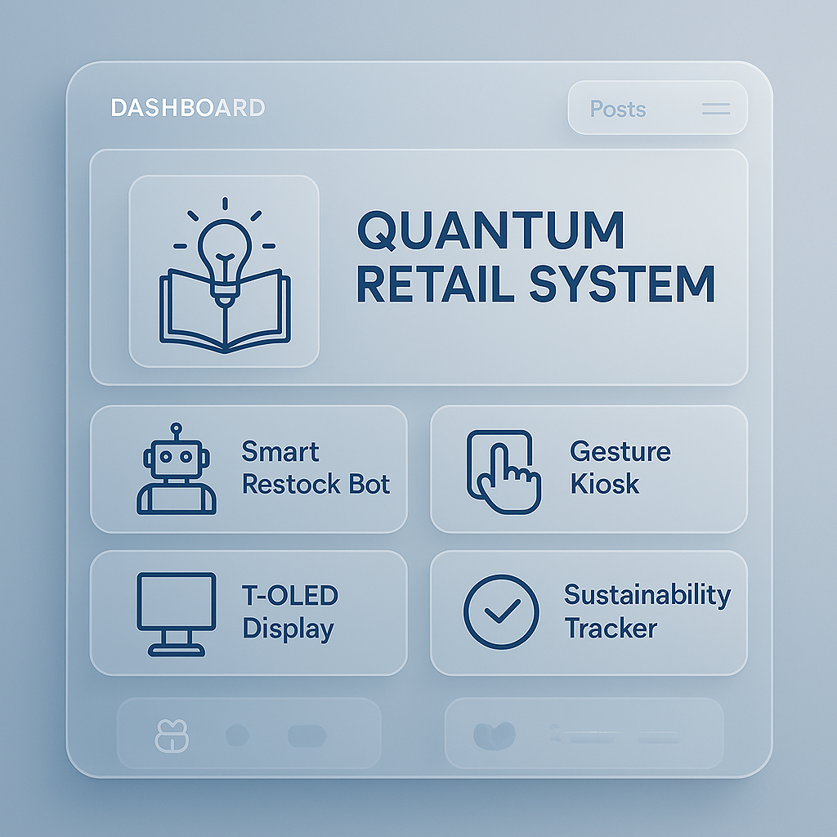

Slide 2


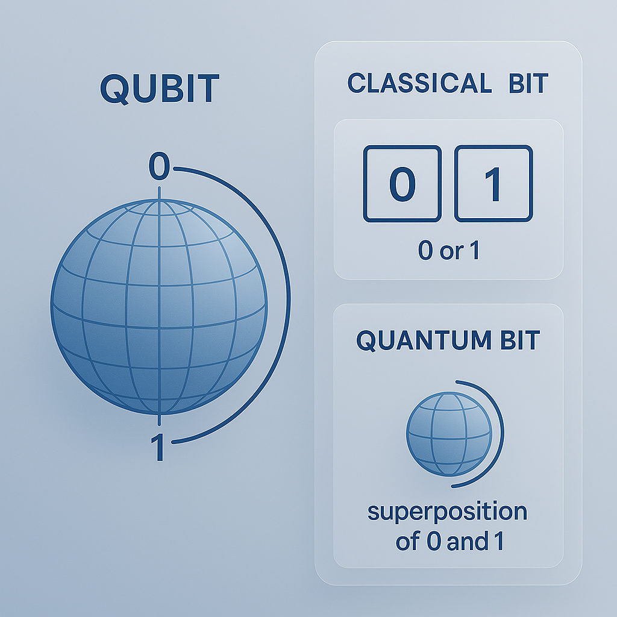
Part of a training series, is now framed as a modular course offering from Logika Learng.
Graduates seeking advanced applications in civic-tech and retail innovation
Working professionals integrating quantum logic into daily workflows and team training
Undergraduates exploring quantum fundamentals and real-world use cases

Slide 3
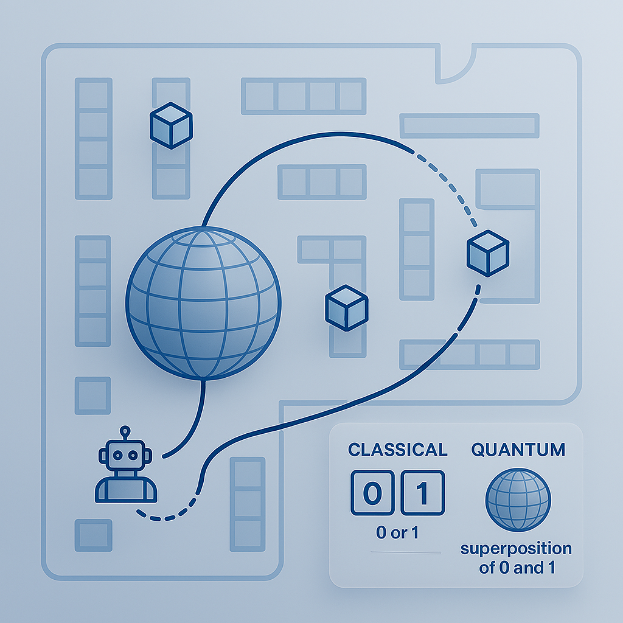

Mission: Transform Retail via Modular Intelligence
Course: Quantum Computing for Retail Robotics
Series: Grad, Undergrad and Current Employed students at Logika Learng

Slide 4
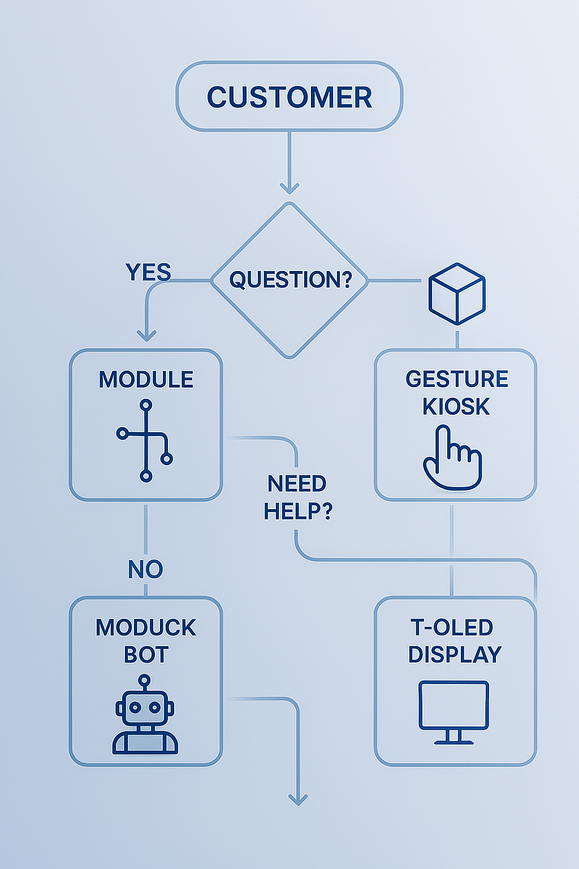
Welcome & Objectives
Welcome to Logika Learng’s Quantum Retail Robotics Training
This course equips learners to:
Grasp quantum computing fundamentals
Connect quantum logic to retail robotics and civic-tech goals
Apply ADA, ESG, and GDPR-aligned systems in real-world retail scenarios
Collaborate across disciplines to build ethical automation

Slide 5

What Is Quantum Computing?
Beyond Classical Logic
Qubits: Simultaneously 0 & 1 (superposition)
Entanglement: Qubits share states instantly across space
Quantum Gates: Logic operations on qubits
Probabilistic Output: Results reflect likelihood, not certainty
For students: Understand how quantum differs from binary logic
For professionals: Learn how probabilistic models improve forecasting

Slide 6

Why Quantum for Retail?
Retail Is a Complex, Dynamic System
Qubits: Simultaneously 0 & 1 (superposition)
Rapid inventory shifts
Unpredictable customer behavior
Adaptive layouts and real-time personalization
Quantum computing enables optimization, prediction, and personalization
For grads: Explore quantum’s role in dynamic systems modeling
For retail teams: Apply quantum logic to store operations

Slide 7

Our Modular Robotics System
Plug-and-Play Intelligence
Smart Restock Bot: Quantum forecasting for inventory
Gesture Kiosk: Personalized product search
T-OLED Display Arm: Layout reconfiguration via traffic data
Sustainability Tracker: ESG metrics powered by quantum logic
For undergrads: Learn modular system design
For co-workers: Operate and optimize the quantum-enhanced tool

Slide 8

Quantum Algorithms in Action
Retail Use Cases
Grover’s Search: Fast product lookup
QAOA: Shelf layout optimization
Quantum Recommendation: Entangled preference modeling
For grads: Dive into algorithmic design
For teams: Use quantum-enhanced kiosks and dashboards

Slide 9
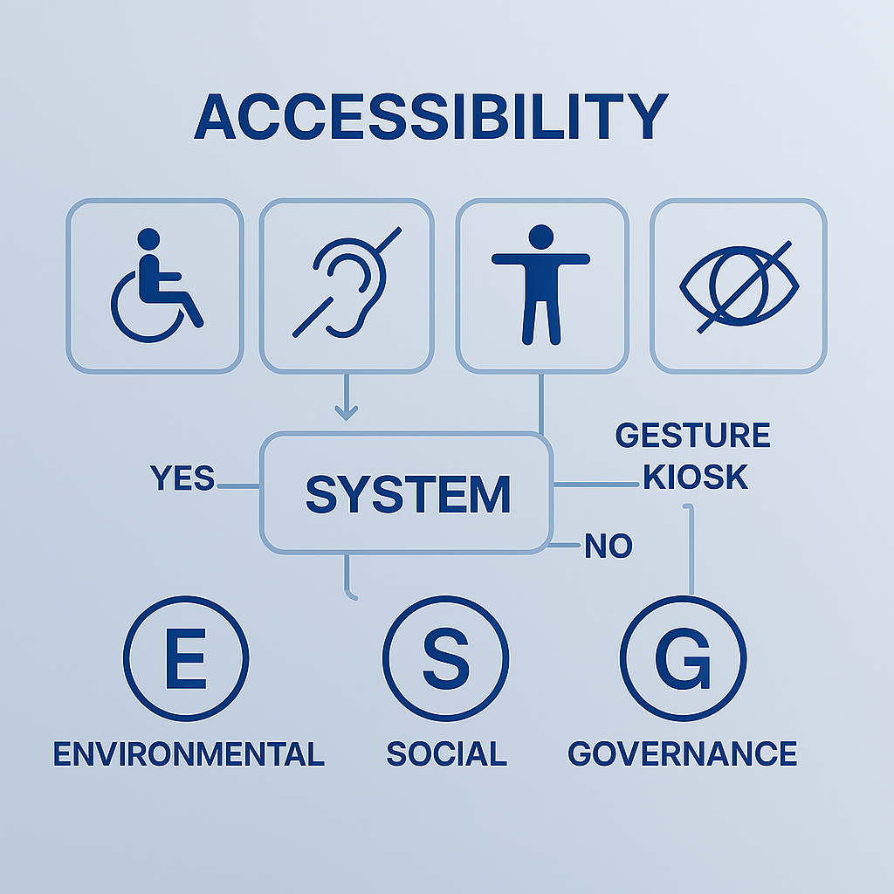
Accessibility & Compliance
Built for Everyone
ADA-compliant interfaces: tactile, visual, voice
Neurodiverse UX: scenario-based personalization
ESG dashboards: real-time sustainability metrics
GDPR-ready: encrypted, consent-based data flows
For students: Understand inclusive design principles
For teams: Ensure compliance in daily operations

Slide 10

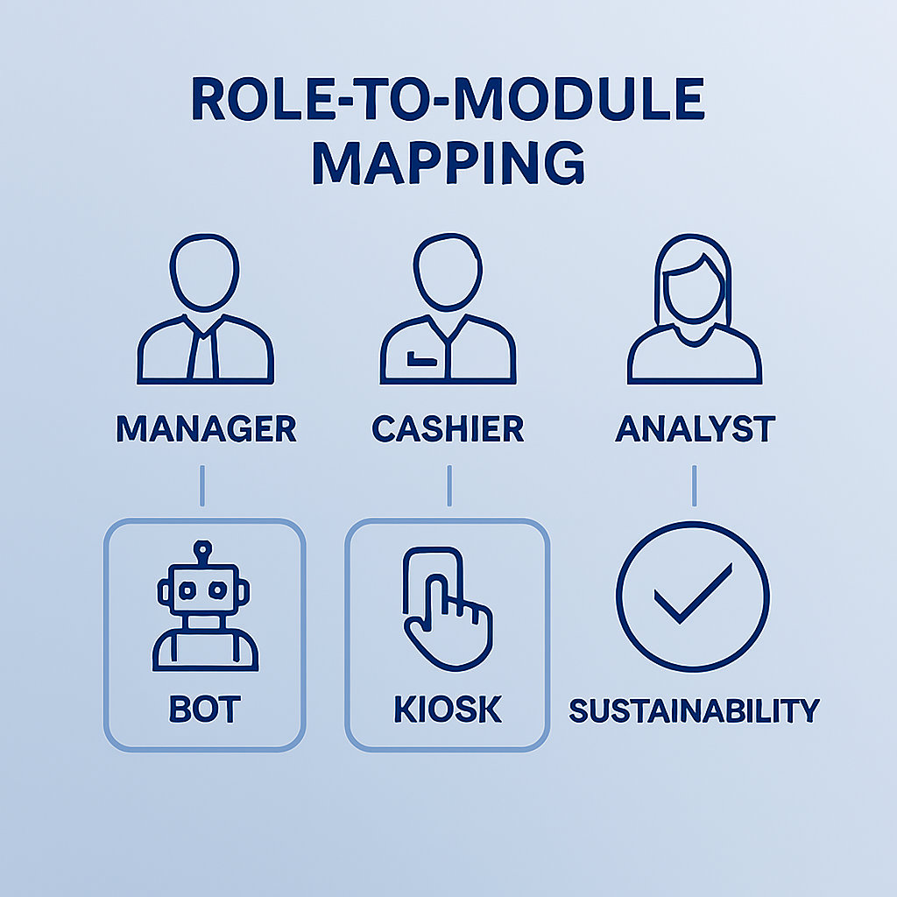
Role-to-module mapping
From Tech to Impact
Engineers: Integrate quantum logic into workflows
Designers: Build inclusive, emotionally intelligent interfaces
Retail Ops: Optimize performance via dashboards
Everyone: Champion ethical, civic-minded automation
For all learners: Map your role to system impact

Slide 11

Global Deployment Strategy
Scaling with Standards
U.S.: ADA, ESG, CCPA
EU: GDPR, CE
Japan: APPI, JIS X 8341
Canada: PIPEDA, CSA B651
For grads: Explore international compliance frameworks
For teams: Localize systems for global deployment

Slide 12
Scenario Studio
Let’s Build Together
Grocery: Quantum restocking + accessibility
Fashion: Personalized fitting room UX
Tech: Gesture-based demos + sustainability tracking
For undergrads: Prototype real-world applications
For co-workers: Collaborate in breakout design labs
Activity: Breakout groups + scenario mapping

Slide 13
Closing & Next Steps
You Are the Future of Ethical Automation
Continue learning: internal wiki + Qiskit sandbox
Share feedback: scenario testing reports
Innovate boldly: every module is a civic-tech opportunity
For learners: Join Logika Learng’s alumni innovation network
For teams: Lead the next wave of modular retail transformation

Slide 14
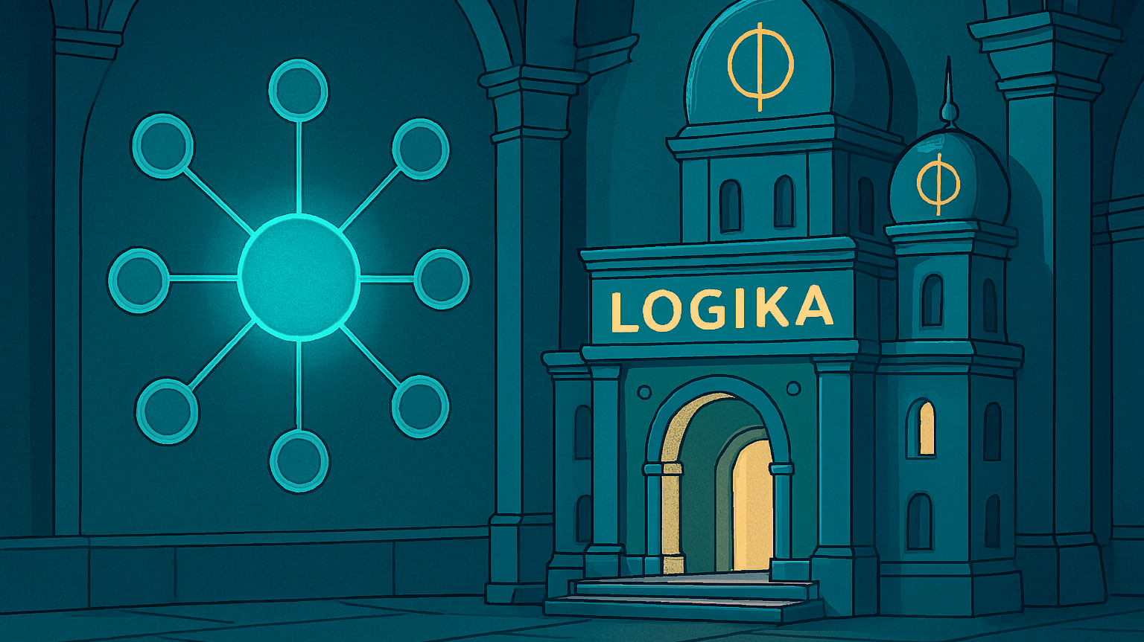
Thank You
Anel.henning165@gmail.com

